Slide 1



Project On

Slide 2
ABOUT ME
My Name is Thirupathi Reddaveni.
I Have Completed My Bachelor Of Commerce (B.Com) Degree.
I Am Passionate About Data Analysis And Aspire To Build A Career As A Data Analyst.
Linked In : Thirupathi Reddaveni | Linkedin

Slide 3

AGENDA: Movie Sales Analysis
Business Problem : Problems.
Data Overview : Understand Dataset Structure , Movie, Year, Genre, Revenue, Rating, Votes, Runtime.
Data Cleaning : Handle missing values, Fix data types, Split multi-genre values, Remove duplicates.
Revenue Analysis : Total Box Office Revenue, Year-wise Revenue Trend, Highest Revenue Year, Top Movies.
Genre Analysis : Most Common Genres, Genre-wise Revenue.
Trend Analysis : Yearly Movie Releases, Peak Years In Box Office.
Visualizations : Cards, Bar Charts, Column Charts, Pie Charts, Tree Map, Trend Line Charts, Tables And Slicers.
Conclusion.

Slide 4
Business Problem: Movie Sales Analysis
The Movie Industry Invests Large Amounts Of Money In Production, Marketing, And Distribution, But Not All Movies Generate Profitable Returns.
Objective:
Understand What Factors Influence Movie Box Office Revenue.
Identify High-performing Genres And Years.
Support Data-driven Decision-making.
Key Questions:
Which Year Recorded The Highest Revenue?
Which Genres Perform Best?
How Do Ratings, Votes, And Runtime Affect Revenue?

Slide 5
LET’S GO FOR VISUALS….

Slide 6
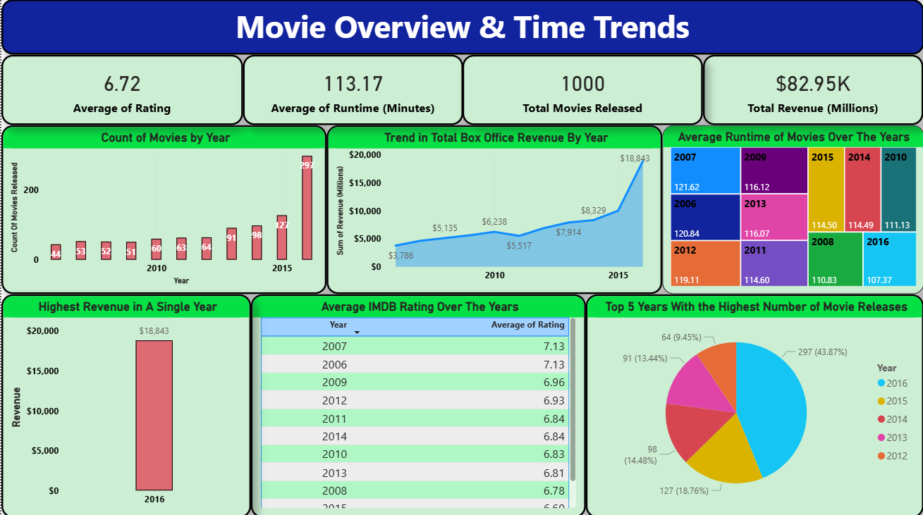

Slide 7
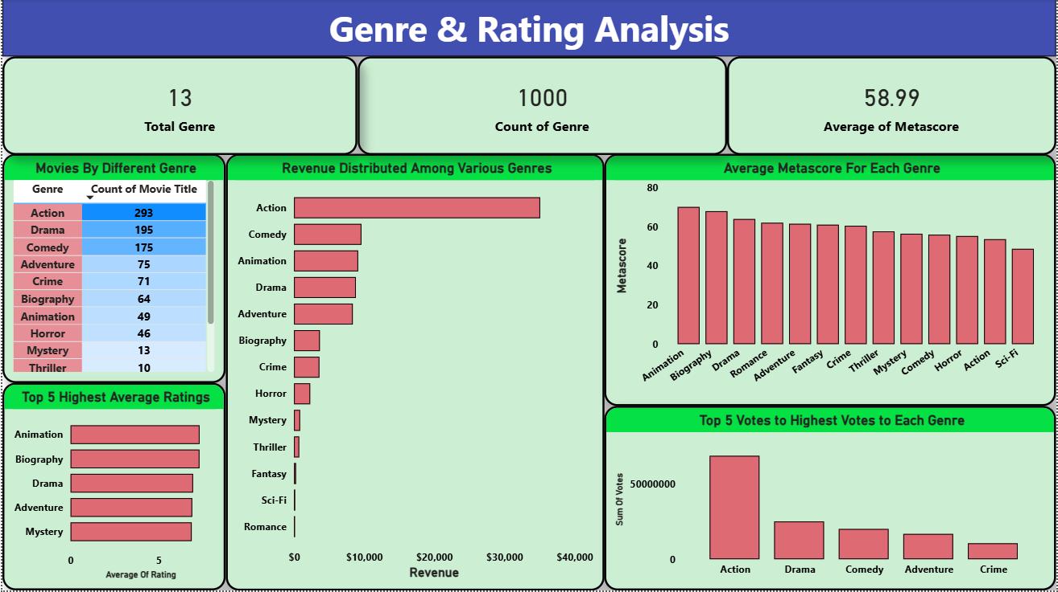

Slide 8
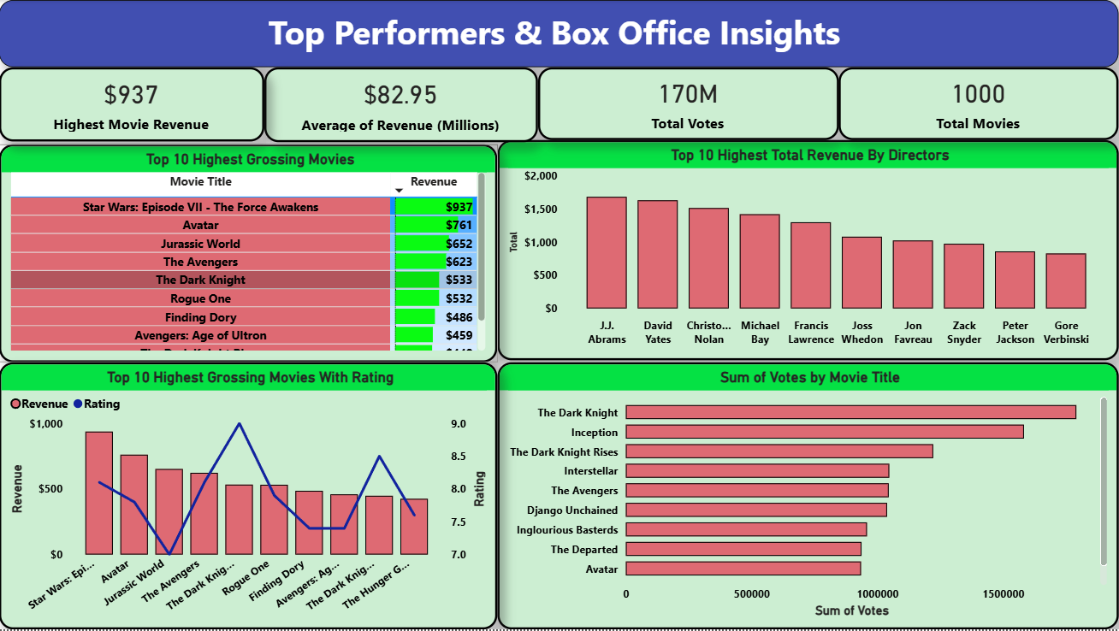

Slide 9
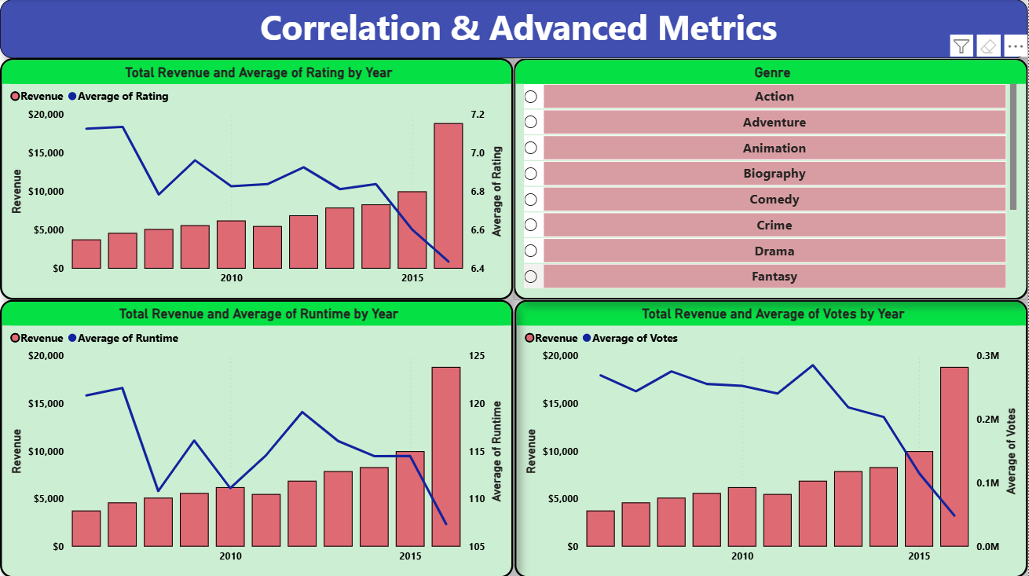

Slide 10
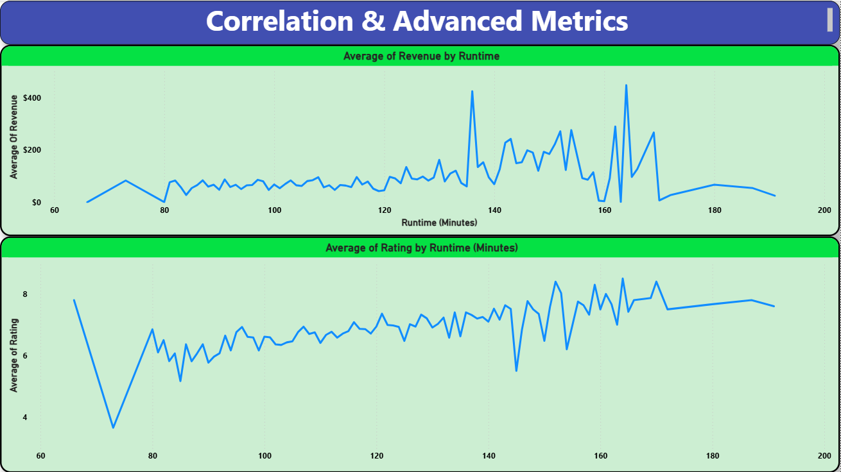

Slide 11
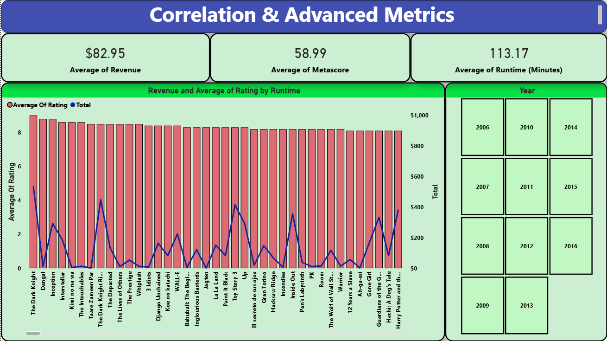

Slide 12
CONCLUSION
Movie Revenue Is Strongly Influenced By Genre, Ratings, And Audience Engagement.
High-rated Movies Generally Generate Higher Box Office Revenue.
Movies With Balanced Runtime Tend To Perform Better Than Extremely Long Or Short Films.
Higher Audience Votes Often Indicate Stronger Box Office Success.
Data-driven Analysis Helps Identify Profitable Opportunities And Reduce Financial Risks.
Using Analytics Enables Better Planning, Budgeting, And Decision-making In The Movie Industry.

Slide 13
INSIGHTS OVERVIEW
Total 644 Directors.
Total $82.95K Million Dollars Earned.
Total 13 Genres.
Total 1000 Movies Are Released.
The Genre Called “Action” Has The Highest Revenue Comparing With Others.( $35,110 Millions )
In All Movies, The Movie Called “The Star Wars: Episode VII The Force Awakens” Got The Highest Revenue ( $937 Millions ).

Slide 14
RECOMMENDATIONS
Focus on High-Performing Genres.
Optimize Movie Release Timing.
Improve Content Quality to Boost Ratings.
Audience Engagement (Votes).
Optimize Movie Runtime.
Invest in Marketing for High-Potential Movies.
Improve Decision-Making with Dashboards.

Slide 15

Any Questions ??

Slide 16


